Slide 1

Smart Sensors
Rishav Pandey
B.Tech (6th sem.)
Electronics & Communication Engineering
Jabalpur Engineering College

Slide 2
What is a Sensor
A sensor is a device that detects the change in the environment and responds to some output on the other system.
A sensor producing an output when combined with some interfacing hardware is termed to be an intelligent or smart sensor, which is a more acceptable term now.
Sensors + Interfacing Hardware = Smart Sensors

Slide 3
Types of Smart Sensors….
Temperature Sensors
Proximity Sensor
Pressure Sensor
Gas & Smoke Sensor
Accelerometer Sensors
Level Sensors
Motion Detection Sensors
Optical Sensors
Gyroscope Sensors

Slide 4
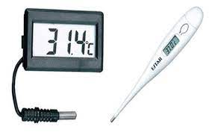
Temperature Sensor
A temperature sensor is an electronic device that measures the temperature of its environment and converts the input data into electronic data to record, monitor, or signal temperature changes.

Slide 5

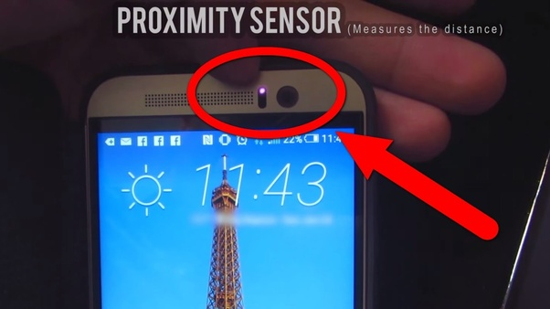
Proximity Sensor
A proximity sensor is a sensor able to detect the presence of nearby objects without any physical contact.
A proximity sensor often emits an electromagnetic field or a beam of electromagnetic radiation, and looks for changes in the field or return signal. The object being sensed is often referred to as the proximity sensor's target.

Slide 6

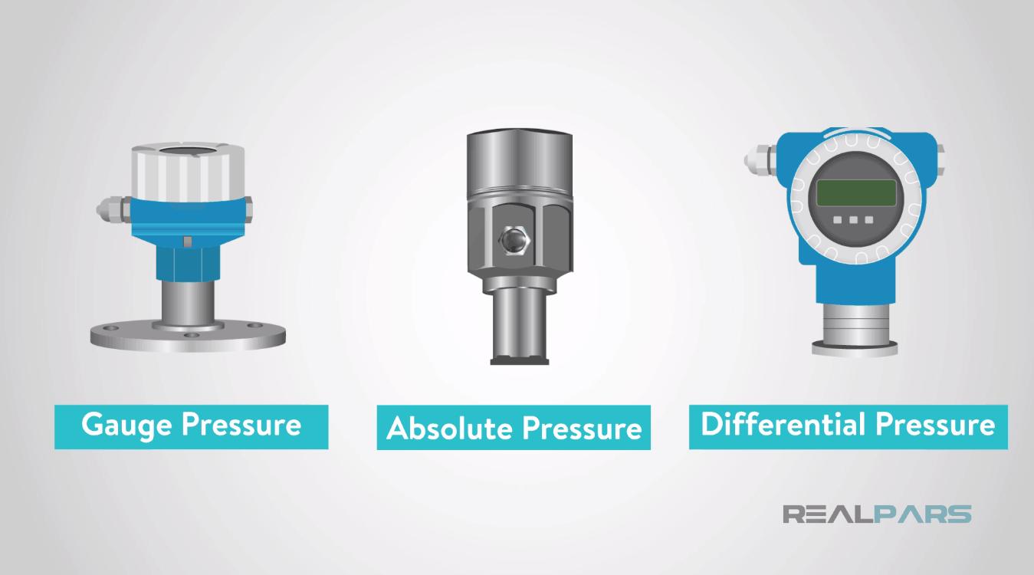
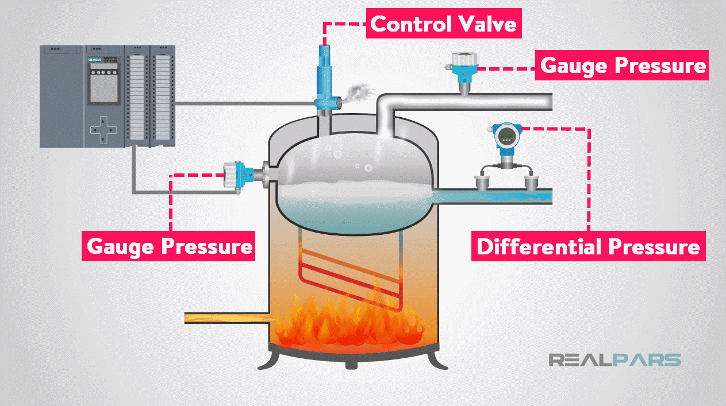
Pressure Sensors….
A pressure sensor is a device that senses pressure and converts it into an electric signal.
A pressure sensor usually acts as a transducer.

Slide 7
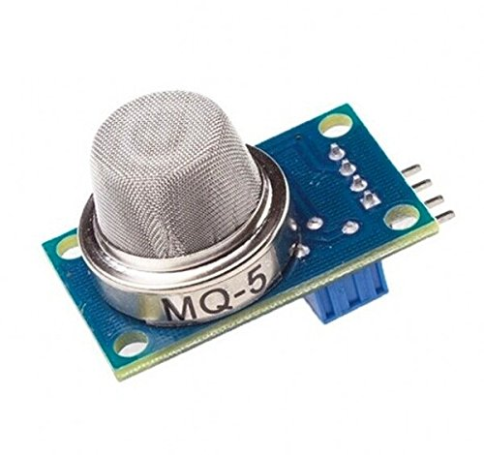
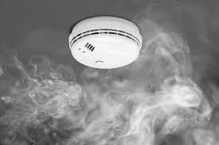
Gas & Smoke Sensors….
Gas sensors are specifically used to monitor changes of the air quality and detect the presence of various gases. A smoke sensor is a device that senses smoke (airborne particulates & gases ) and it’s level.

Slide 8
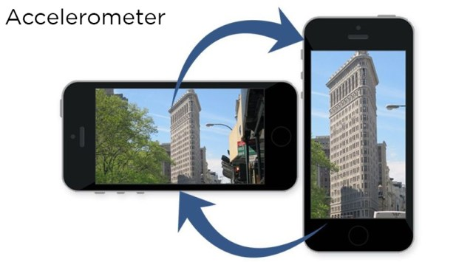
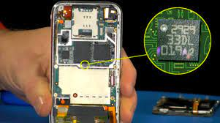
Accelerometer Sensors….
Accelerometer is a transducer that is used to measure the physical or measurable acceleration experienced by an object due to inertial forces and converts the mechanical motion into an electrical output.
Accelerometers in mobile phones are used to detect the orientation of the phone.

Slide 9
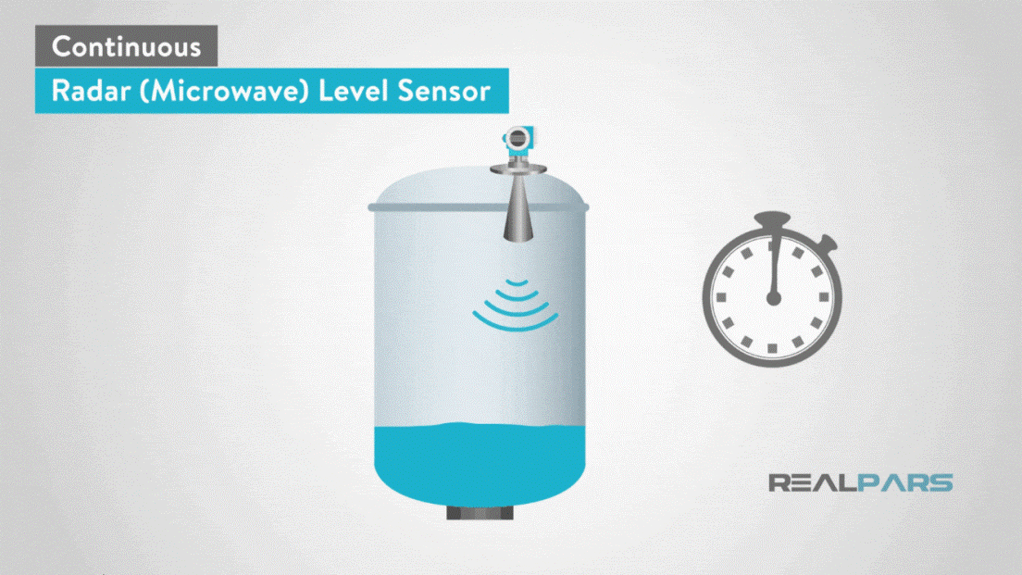
Level Sensors….
A sensor which is used to determine the level or amount of fluids, liquids or other substances that flow in an open or closed system is called Level sensor.

Slide 10
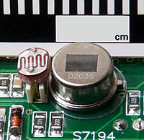
Motion Detection Sensors….
A motion detector is an electronic device which is used to detect the physical movement(motion) in a given area and it transforms motion into an electric signal ; motion of any object or motion of human being.
Ex- Passive infrared (PIR), in household motion sensing devices and is designed to turn on a light only when motion is detected and when the surrounding environment is sufficiently dark.

Slide 11
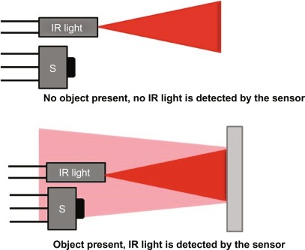
Optical Sensors….
A sensor which measures the physical quantity of light rays and convert it into electrical signal which can be easily readable by user or an electronic instrument/device is called optical sensor.

Slide 12
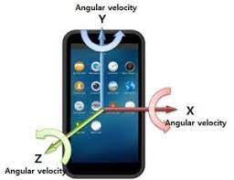
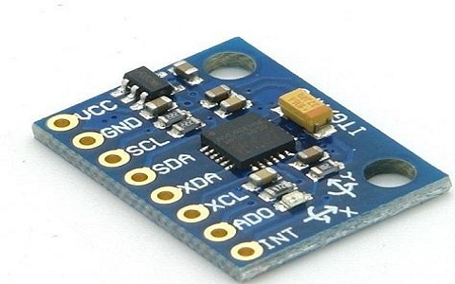
Gyroscope Sensors….
A sensor or device which is used to measure the angular rate or angular velocity is known as Gyro sensors. The most important application is monitoring the orientation of an object.

Slide 13



